Slide 1
Islam and Arab Civilization
Dr. Md. Faruk Shah
Adjunct Faculty Member
Department of History and Philosophy
North South University

Slide 2

Lecture Outline of the Growth of Islam and Arab
The foundation of Islamic regime in Arabia
Founder and Teaching of Islam
Expansion of Islam
The Early Caliphate and its contributions
Islamic Golden Age: Abbasid Caliphate
Economy and Trade
Art and Literature
Achievements in Medicine, Mathematics, and the Sciences
The Ottoman Empire and its contributions

Slide 3
Introducing Islamic Civilization
During the 7th century, the religion of Islam rose in the Middle East.
Like Christianity, Islam had a profound impact on human history.
Within 100 years Islamic follower built an empire that was larger than the Roman Empire.
Islamic civilization based on the rich heritages of Greek, Roman, Persian and Indian cultures.
Muslims blended these traditions to create their own distinct civilization.
Muslims played a significant role in shaping civilization in Western Europe because they transmitted many ideas to the peoples of Europe.

Slide 4
Geographical Location
Arabia, the birthplace of Islam, is the largest peninsula in the world.
It is a hilly and fertile areas with enough water to support trees and plants.
The Arabs developed a way of life well adapted to desert conditions.
Most Arabs were nomads who herded goats and camels.
Through trade, people had contact with the civilizations of the Greco-Roman world, India, China & Africa.
Mecca, prospered both as a trading center and as an important religious center.

Slide 5
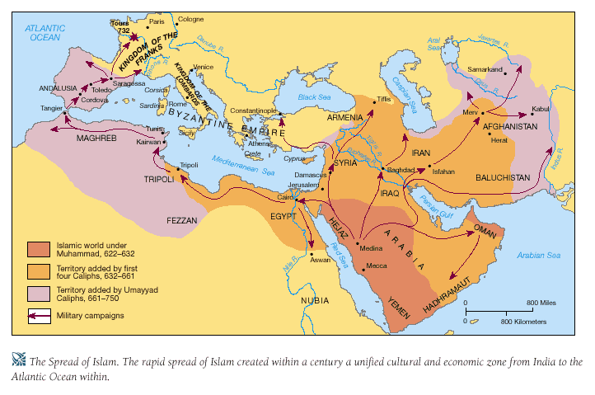
Spread of Islam

Slide 6
Prophet Muhammad: Founder of Islamic Civilization
Muhammad was born in Mecca about 570 A.D.
He was troubled by the violence in the world.
He often went into the desert to pray.
Muhammad believed that the angel Gabriel spoke to him, saying that God had chosen Muhammad to be his prophet.
Muhammad's duty was to proclaim that Allah was the one and only God.
At first, only Khadija and a few friends believed Muhammad.
The merchants and landlords of Mecca opposed him.

Slide 7
Expansion of Islam
Between 622 and 732, Islam spread with amazing speed.
The Arabs carried their religion to the peoples of Palestine and Syria and across North Africa into Spain.
Just as swiftly, Islam won converts from the Fertile Crescent east to the Indus Valley.

Slide 8
Causes of the Expansion of Islam
Its message was clear and simple.
Muslims believed in one God and the equality of all believers.
Muhammad and his successors united the Arabs for the first time
Inspired by loyalty to Islam, Arab soldiers believed that if they died fighting for the faith they would immediately enter paradise.
When Muslim armies conquered parts of the Byzantine Empire, some Christians, Jews, and Zoroastrians were ready to accept the teachings of Islam. Yet Muslims did not force people to convert.

Slide 9
Salat
Prayer
Muslims must face Mecca five times daily and pray
Hajj
Pilgrimage
Say: “There is no god but Allah, and Muhammad is his Prophet”
Accepting God
Shahadat
Zakat
Alms
Means giving to the poor
Siwm
Fasting
Muslims must fast during Ramadan
Able-bodied Muslims who can afford it must travel to Mecca

Slide 10
Similarities Between Islam, Judaism and Christianity
Some teachings of Islam are similar to those of Judaism and Christianity.
Muslims share with Jews and Christians the belief in one God.
Like Jews and Christians, Muslims believe in a last judgment day, when people will be rewarded or punished, depending on how they conducted their lives.
Muslims also believe that Abraham, Moses, and Jesus were great prophets. But Muhammad, as God's final messenger, has the highest authority.

Slide 11
Period of Righteous Caliphs
THE FIRST FOUR CALIPHS, who truly followed the Quran and the Sunnah, are known as the ‘Rightly Guided Caliphs’. They are Abu Bakr, Omar, Uthman and Ali. Main characteristics of their rule are:
assumed office only with the consent of the people and never imposed themselves through force and fraud;
governed the people through ‘shura’ (consultation) and were not inclined toward oppression and dictatorship;
state and its functionaries were committed to the establishment of a moral order;
committed to the rule of law and the constitutional order.

Slide 12
Economic Prosperity
Islamic Empire directed the vital trade routes of the world.
Muslim merchants handled the products of Africa, Asia & Europe.
The Abbasid capital boasted hospitals, libraries, palaces, public gardens & street lighting.
Introduced the use of letters of credit in place of cash.
Merchants and bankers in Western Europe later adopted these practices from the Arabs.
Manufacturing flourished-steel used in swords and textiles were the most important industries.
Improvements in agriculture helped farmers produce more food to feed large city populations.

Slide 13
Traditions of Learning
Islam had an impact on many fields of learning.
Muhammad taught that "the ink of the scholar is holier than the blood of the martyr.''
The Koran was the focus of much Muslim scholarship.
Legal experts wrote many texts in which they interpreted the Koran.
Islamic law, along with common religious beliefs and the use of Arabic, helped unite Muslims.
Yet Muslim scholars did not limit their studies to the Koran. They translated ancient Greek works on philosophy and science.
At centers of learning such as the House of Wisdom in Baghdad, scholars also studied Roman, Jewish, Persian, and Indian texts. In this way, the Arabs preserved much ancient learning.

Slide 14
Achievements in Medicine, Mathematics, and the Sciences…
Muslim scholars made original contributions in medicine, mathematics, & other sciences.
Guided by ancient Greek texts, Muslim doctors perfected techniques for diagnosing and treating diseases.
Muhammad al-Razi published a huge medical encyclopedia called the Comprehensive Work in Medicine.
Muslims also set up an advanced system of medical training, which included a qualifying examination for doctors and pharmacists.
Medical schools in Europe later drew on Muslim medical research and practices.
Muslim mathematicians studied the works of ancient scholars such as Euclid.

Slide 15
Achievements in Medicine, Mathematics, and the Sciences
Muslims also adopted the decimal system and the system of numerals from India.
With the decimal system, Muslims made advances in algebra and trigonometry.
Like the Greeks, Muslim scientists were interested in all aspects of the natural world.
Muslims used the magnetic needle, invented by the Chinese, to produce the mariner's compass.
https://www.youtube.com/watch?v=IXrC3oDB80E
https://www.youtube.com/watch?v=gg-oyrOFosY
https://www.youtube.com/watch?v=Hm4Sg086uLg

Slide 16
Effect of Islam on the Status of Women
The Koran gave women a legal and economic status.
Before Islam, Arab women had no property rights. They were entirely at the mercy of their fathers or husbands.
Islamic law gave women inheritance rights and control over own property.
The Koran strictly forbade the killing of unwanted baby, a common practice in many ancient cities.
If she were divorced, her family took care of her. If her husband died, her sons looked after her. An unmarried woman could rely on her father or brothers to protect her.
A woman's duties were to obey her husband, care for the children, and manage the household.
As head of the household, the man enjoyed complete authority. But within her home, a woman could, and often did, exercise considerable influence.

Slide 17
Gender Roles
Role of Women:
Forbade the custom of killing female infants
Limited polygamy (maximum of four wives)
Had control of personal property
Made contributions to the arts
Role of Men:
Obligated to politics and military
Visited public forums for various activities
Entered school at the age of seven
Upper-class boys could pursue a theological degree

Slide 18
The Arts and Literature
Muslims adapted ideas in architecture from the many peoples.
Mosques reflected a blend of Roman, Byzantine, and Persian styles.
Columns supported domed roofs similar to those of Byzantine churches.
Romantic themes often inspired poetry. Poet Omar Khayyam wrote about nature and love.

Slide 19
Arab Thinker: Ibn Khaldun
Set standards for the scientific study of history.
Stressed that economics and social structure were the causes of historical events.
Warned historians to watch for bias and exaggeration.

Slide 20
Achievement of Islamic Civilization
Mathematics:
Developed algebra; expanded trigonometry
Astronomy and Geography:
Physical and Mathematical models of universe
Concluded that the Earth was round
Chemistry and Medicine:
Al-Razi: described the origin of disease
Art:
Calligraphy writing
Philosophy and History
Religious truths could be analyzed

Slide 21
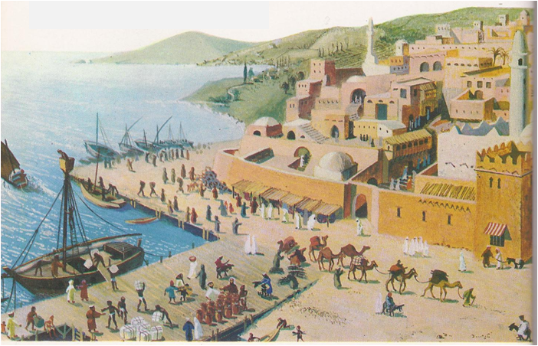
What was the Golden Age of Islam?

Slide 22
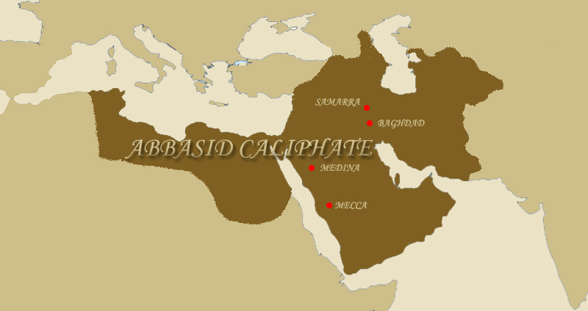
The Golden Age of Islam was a time of great cultural and economic achievements for Muslims under the Abbasid Dynasty, from 750 to 1258.

Slide 23
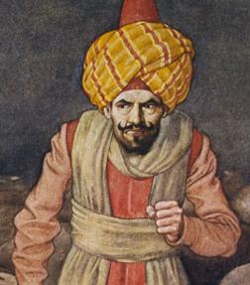
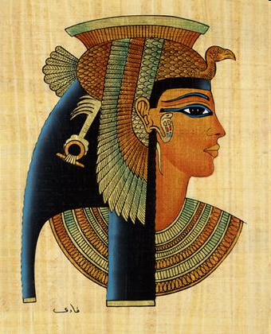
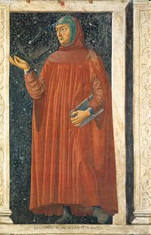
During this time, cultural diversity was accepted and Arab culture was mixed with other cultures.
Arabian culture
Egyptian culture
European culture

Slide 24
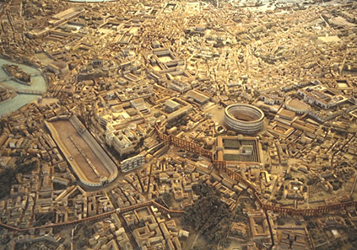
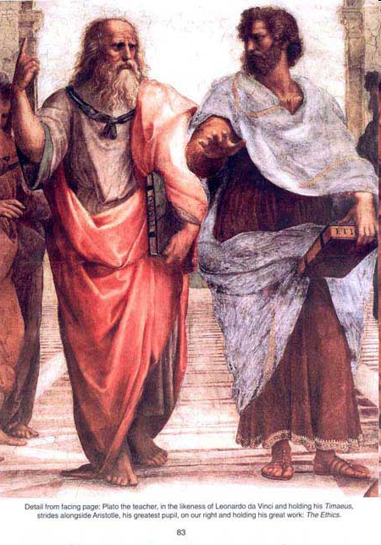
An important achievement of the Abbasid Dynasty was the preservation of ancient Greek and Roman ideas.
Plato and Aristotle

Slide 25
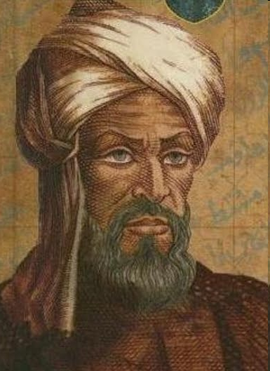
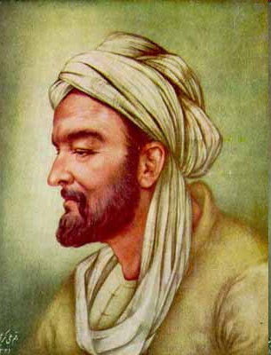
This resulted in Muslim advances in mathematics, science, and medicine.
al-Khwarizmi (Mathematician)
Ibn Sina (Physician)

Slide 26
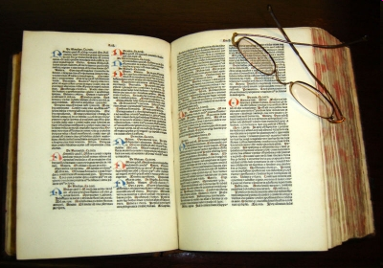



The first medical licensing exams, medical textbooks, emergency rooms, and syrup for medicine were also developed by the Abbasid Dynasty.
Canon on Medicine

Slide 27
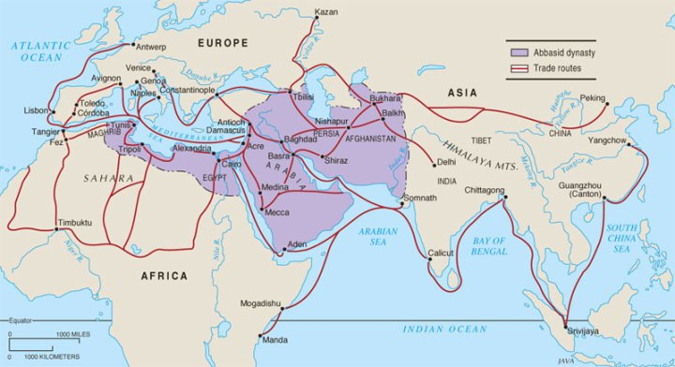
A large trading network was developed by the Abbasid Dynasty, which allowed Muslims to spread their ideas and become very wealthy.

Slide 28
“The Ottoman Empire”

Slide 29
Origins of the Ottoman Empire
After Muhammad’s death in 632 A.D., Muslim faith & power spread throughout Middle East

Slide 30
THEN . . .
A new empire arose out of the leftovers of the old sultanates (kingdoms) of Anatolia (Turkey).
1299 A.D.- one of these sultans (Osman) began to expand his kingdom
Osman started the Ottoman Empire, named after him.

Slide 31
ORIGINS of the Ottoman Empire
It was one of the largest & longest lasting empires in history
It was an empire supported & inspired by Islam
It replaced the Byzantine Empire (former Roman Empire) as the major power in the Eastern Mediterranean.

Slide 32
Religion
Founded on the principles of Islam
United by Islamic beliefs
Tolerant of other religions, especially Christians and Jews
Encouraged loyalty from other religious faith groups
Notes:
, especially

Slide 33
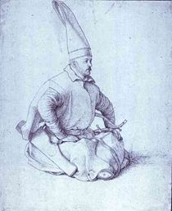
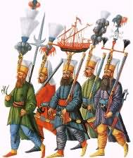
The Janissaries
Group of soldiers loyal to the sultan (king)
Army of slaves & Christian converts to Islam
Helped to expand the empire

Slide 34
Origins cont.
1352 A.D. sultans able to cross over into Europe
1453 A.D.-Ottoman soldiers known as Janissaries conquered Constantinople (Istanbul) from the Byzantine empire, thus ending the Roman Empire.
1517 A.D. Ottomans had control of Egypt & extended control to most of North African coast.
1520-1566: peak of power during rule of Suleiman (“The Magnificent”)

Slide 35
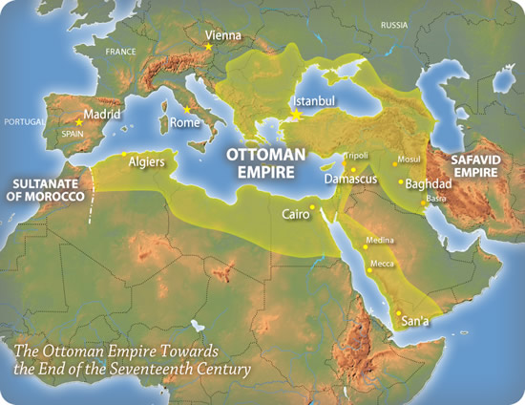
Ottoman Map 1

Slide 36
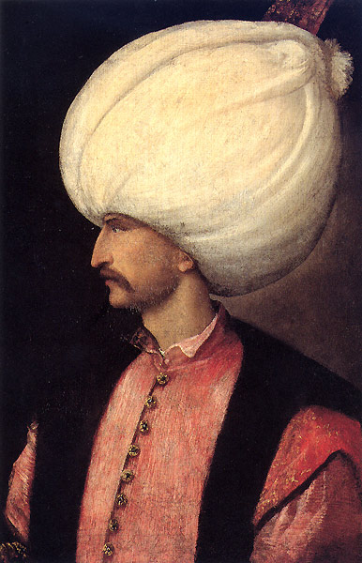
Suleiman
Ruled from 1520-1566
Made Ottoman Empire the richest & most powerful empire in Europe and Southwest Asia at the time

Slide 37
Suleiman
Greatest Ottoman leader of all time
Brought justice & harmony by publishing a code of laws (“The Lawgiver”)
Feared & respected by Europeans
Turned Constantinople into a great center of art, music, writing, and philosophy
Wrote some of the most beautiful poetry of his time

Slide 38
Expansion
Suleiman believed that the entire world was his possession as a gift of God.
Vast amounts of Islamic territories were annexed or invaded.
Very strong military
Expert in developing gunpowder as a military tool

Slide 39
Thank You and Questions???

